Slide 1

IILM UNIVERSITY, GREATER NOIDA
INTERNSHIP REPORT PRESENTATION
Cybersecurity
Job Simulation
Mastercard | Hosted on Forage
Aditya Sharma
Roll No. 2410030343 | B.Tech CSE | September 2026

Slide 2






ABOUT THE STUDENT
Candidate Profile
Roll Number
2410030343
Institute
Aditya
Sharma
IILM University, Greater Noida, U.P.
Programme
B.Tech CSE, Batch 2024-2028
B.Tech - Computer Science & Engineering
Simulation
Mastercard Cybersecurity Job Simulation
Duration
September 2026 | Self-paced, virtual
Cybersecurity Job Simulation | Aditya Sharma
02

Slide 3



ABOUT THE PROGRAM
Mastercard, Forage & Job Simulations
Forage hosts free, self-paced virtual work-experience programmes, called job simulations, built with leading employers. In the Mastercard Cybersecurity Job Simulation, participants complete practical tasks modelled on the work of a corporate security team and receive a Certificate of Completion from Forage.
Mastercard
Forage
Certificate
Global payments technology company with security awareness at the core of its work.
Online platform for free, self-paced virtual job simulations.
Certificate of Completion issued by Forage on 20 September 2026.
Cybersecurity Job Simulation | Aditya Sharma
03

Slide 4





PROBLEM STATEMENT
From Phishing Theory to Practice
Phishing works because it targets people, not software. Students usually learn it only as theory, with little practice in designing an awareness exercise or reading its results. This simulation addressed that gap: design a phishing email simulation, then interpret the results to guide what an organisation should do next.
The skills practised, end to end:
Understand Threat
Design Simulation
Interpret Results
Recommend Action
Cybersecurity Job Simulation | Aditya Sharma
04

Slide 5





PROJECT OBJECTIVES
What the Simulation Set Out to Achieve
Understand Phishing
Design a Simulation
Interpret Results
How phishing and social engineering work, and which indicators make an email convincing or suspicious.
Plan a phishing email simulation that tests and improves employee awareness.
Read simulation results and identify what they say about user behaviour.
Recommend Actions
Work Safely
Complete & Certify
Turn findings into practical steps such as training and reporting guidance.
Practise in a controlled, virtual setting with no live systems or real targets.
Finish both practical tasks and earn the Forage Certificate of Completion.
Cybersecurity Job Simulation | Aditya Sharma
05

Slide 6





CONCEPTS & TOOLS
The Ideas Behind the Simulation
Forage Platform
Phishing
Spoofed Senders
Urgency Tactics
Virtual job simulation
Social engineering by email
Look-alike identities
Pressure to act fast
Suspicious Links
Click Rate
Report Rate
Awareness Training
Risky links & attachments
Who clicked the lure
Who reported the email
Turning results into action
Cybersecurity Job Simulation | Aditya Sharma
06

Slide 7


SYSTEM ARCHITECTURE
The Phishing Simulation Lifecycle
Threat Layer
How attackers use phishing and who they target
Design Layer
Scenario, sender, subject, message and red flags
Delivery Layer
Controlled sending to an authorised audience
Measurement Layer
Opens, clicks and reports collected
Analysis Layer
Patterns, risky behaviours and groups needing support
Response Layer
Recommendations, training and reporting guidance
Cybersecurity Job Simulation | Aditya Sharma
07

Slide 8
METHODOLOGY
Two Practical Tasks, One Workflow
1
TASK
2
TASK
Design a phishing email simulation
Interpret phishing simulation results
Plan and design a simulated phishing email that tests employee awareness in a safe, controlled way, with a clear learning objective.
Analyse the outcome of a phishing simulation, identify what it reveals about staff behaviour, and draw conclusions and recommendations.
Self-paced, completed in September 2026. Recognised by a Certificate of Completion (20 September 2026); no stipend, no graded assessment.
Cybersecurity Job Simulation | Aditya Sharma
08

Slide 9

EXPECTED OUTCOMES
Skills & Capabilities Gained
Explain how phishing attacks work and recognise their common indicators
Design a realistic but safe phishing simulation with a clear awareness objective
Read simulation results and identify risky behaviours and at-risk groups
Recommend practical actions, such as training and reporting improvements
Completed both practical tasks and earned a Forage Certificate of Completion
Cybersecurity Job Simulation | Aditya Sharma
09

Slide 10
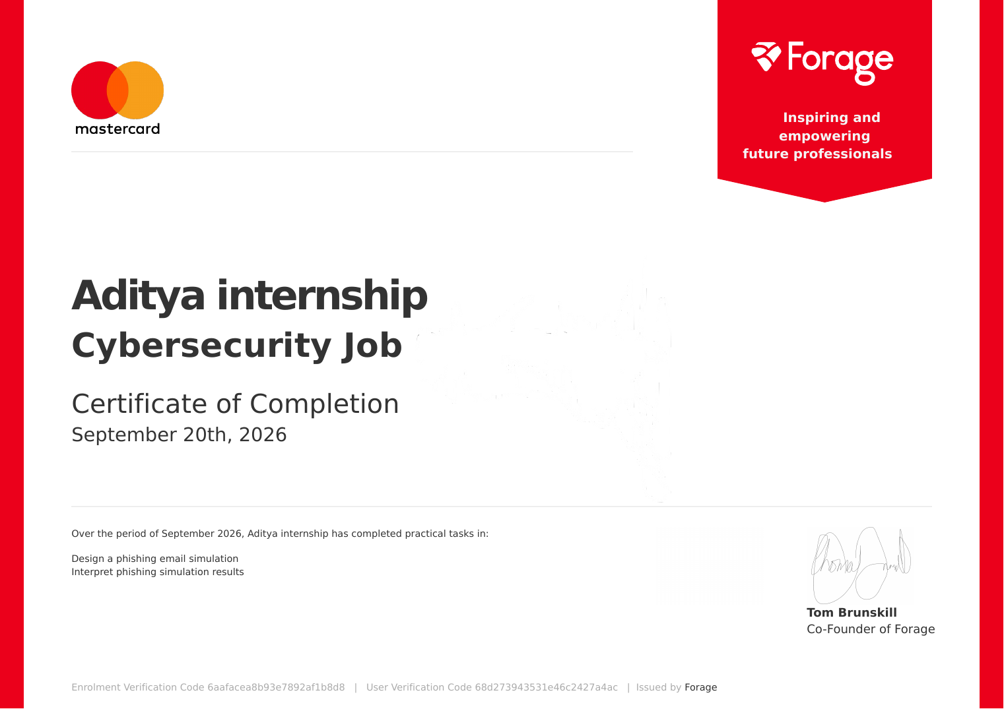



CERTIFICATION
Successfully Completed
Certificate
Certificate of Completion - Forage
Date of Issue
20 September 2026
Enrolment Verification Code
6aafacea8b93e7892af1b8d8
User Verification Code
68d273943531e46c2427a4ac
Cybersecurity Job Simulation | Aditya Sharma
10

Slide 11
Thank You
Mastercard Cybersecurity Job Simulation | Forage
Aditya Sharma
Roll No. 2410030343 | IILM University, Greater Noida

